Slide 1
Capstone Project
CoronaVirus Tweet Sentiment Analysis

Slide 2

Road map
Aim of Our project
Why Sentiment Analysis
Data Summary
Exploratory data Analysis
Insights from EDA
What and Why Pre-processing?
Model Training
Count Vectorisation Method
Tf-IDF Method
Comparison of both method
Conclusion

Slide 3
Aim of our project
This challenge asks you to build a classification model to predict the sentiment of COVID-19 tweets. The tweets have been pulled from Twitter and manual tagging has been done then.

Slide 4
What is Sentiment Analysis
Sentiment analysis (or opinion mining) is a natural language processing technique used to determine whether data is positive, negative or neutral. Sentiment analysis is often performed on textual data to help businesses monitor brand and product sentiment in customer feedback, and understand customer needs.

Slide 5
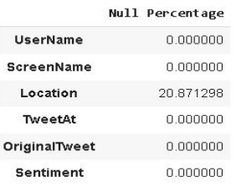
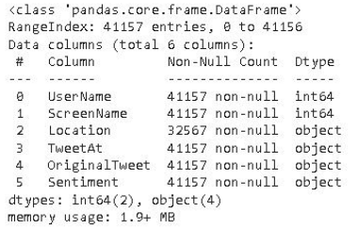
Data Summary
The following images gives basic detail about our data.
Total Number of rows are 41156
Data of type int64(2) and Object(4) are only present
Location column has some null values.
About 20.8% null values are present in location column, whereas all other columns are clean

Slide 6
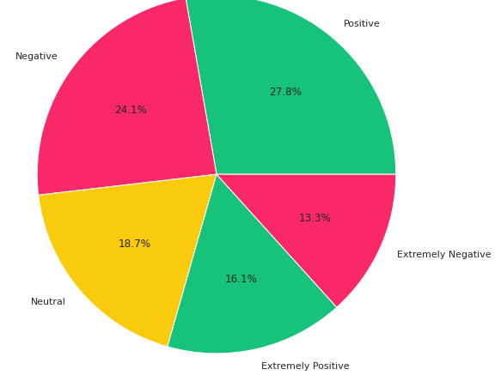
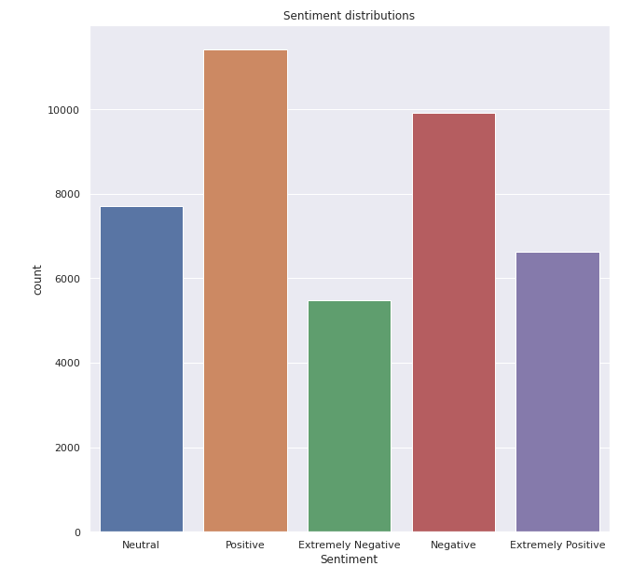
Exploratory Data Analysis Sentiment Distribution

Slide 7
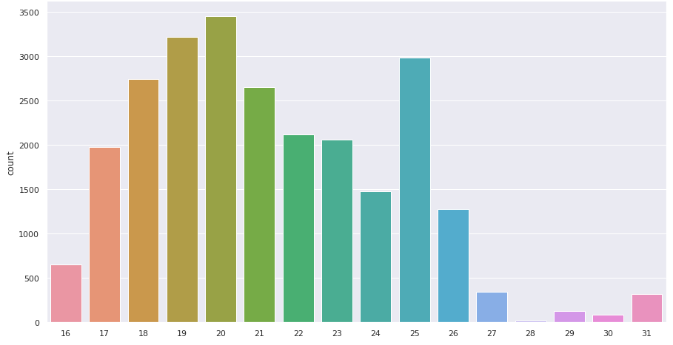
Tweet distribution in March
As we can see that above graph users were most active between 17/03 to 26/03

Slide 8
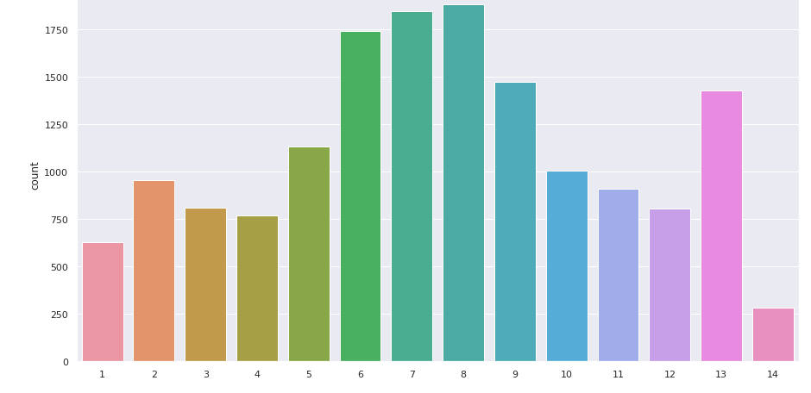
Tweet distribution in April
Here we can see Users were most active between 06/04 to 09/04

Slide 9
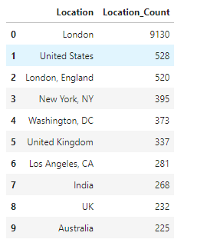
Most tweets
Top 10 locations which has most tweets from them.

Slide 10
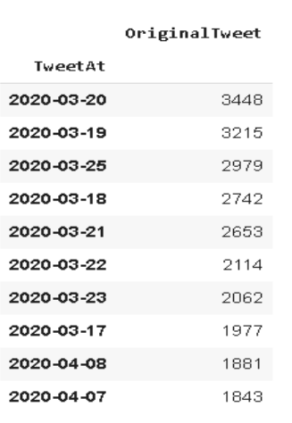
Top 10 dates on which maximums tweets have been made.

Slide 11
Insights from EDA
1) From sentimental distribution, it was clear that 24.1% people tweets something positive, which is help-full.
2) There are a total of 12220 unique locations of tweets.
3) London has most active people who tweets related to covid-19.
4) India Ranks 7th in most active locations with an average of 4.4 tweets related to corona per day.
5) 20 MARCH 2020 had most number of tweets related to corona, with main as lockdown in most country had started on that day.

Slide 12
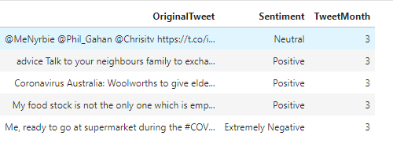
Pre-processing of data
The pre-processing of the text data is an essential step as it makes the raw text ready for mining, i.e., it becomes easier to extract information from the text and apply machine learning algorithms to it. If we skip this step then there is a higher chance that you are working with noisy and inconsistent data. The objective of this step is to clean noise which is less relevant to find the sentiment of tweets such as punctuation, special characters, numbers, and terms which don’t carry much weightage in context to the text.

Slide 13
Model Training Count Vectorizer Method
In order to use textual data for predictive modelling, the text must be parsed to remove certain words – this process is called tokenization. These words need to then be encoded as integers, or floating-point values, for use as inputs in machine learning algorithms.
Scikit-learn’s Count Vectorizer is used to convert a collection of text documents to a vector of term/token counts .it also enables the pre-processing of text data prior to generating the vector representation. This functionality makes it a highly flexible feature representation module for text

Slide 14
Different models used
1. Logistic regression
2. Decision trees classifier
3. Multinomial naive bayes classifier

Slide 15
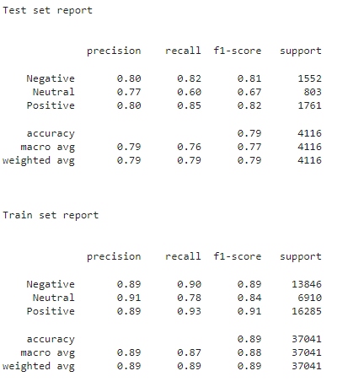
Logistic regression metrics

Slide 16
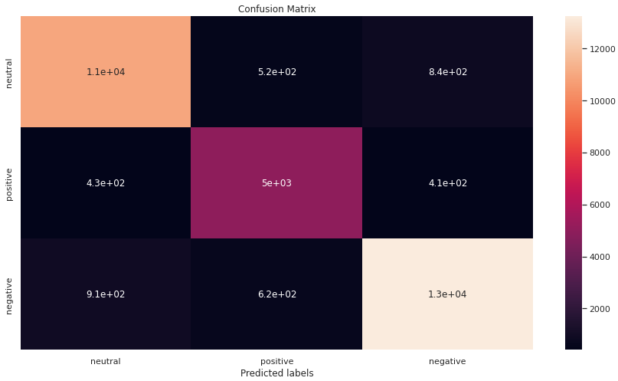
Logistic regression confusion matrix
Train set

Slide 17
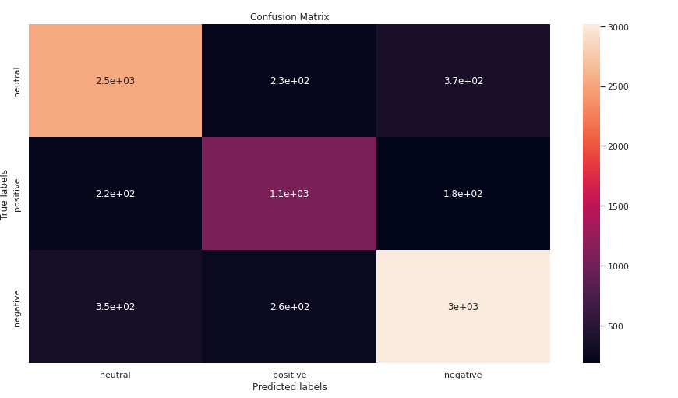
Contd….
Test Set

Slide 18
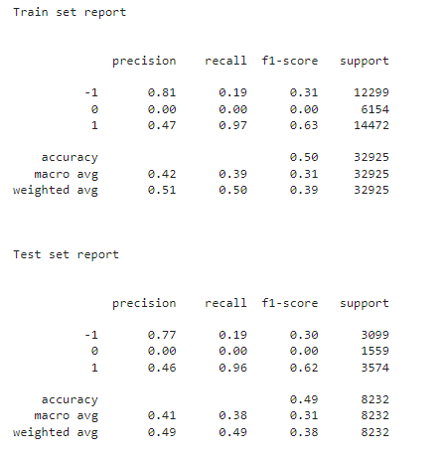
Decision trees classifier metrics

Slide 19
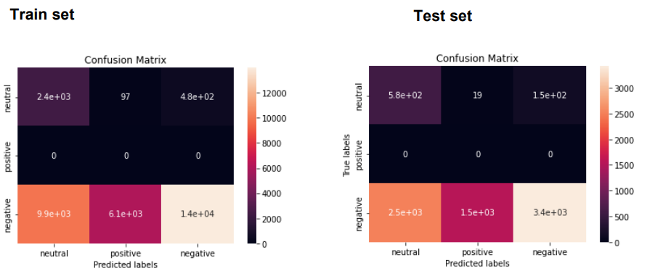
Décision trees classifier confusion matrix

Slide 20
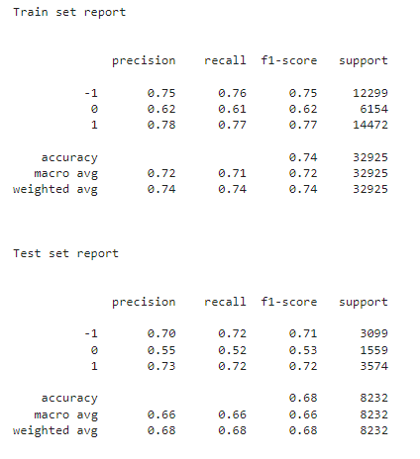
Multinomial naive bayes metrics

Slide 21
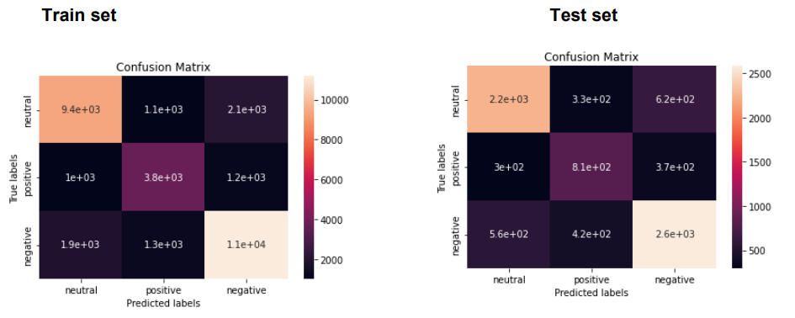
Multinomial naive bayes confusion matrix

Slide 22
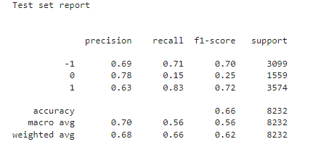
Hyperparameter tuning

Slide 23
B) Tf-IDF Method
This is another method which is based on the frequency method but it is different to the bag-of- words approach in the sense that it takes into account, not just the occurrence of a word in a single document (or tweet) but in the entire corpus. TF-IDF works by penalizing the common words by assigning them lower weights while giving importance to words which are rare in the entire corpus but appear in good numbers in few documents. Let’s have a look at the important terms related to TF-IDF:
• TF = (Number of times term t appears in a document)/(Number of terms in the document)
• IDF = log(N/n), where, N is the total number of documents and n is the number of documents the term t has appeared in.
• TF-IDF = TF*IDF

Slide 24
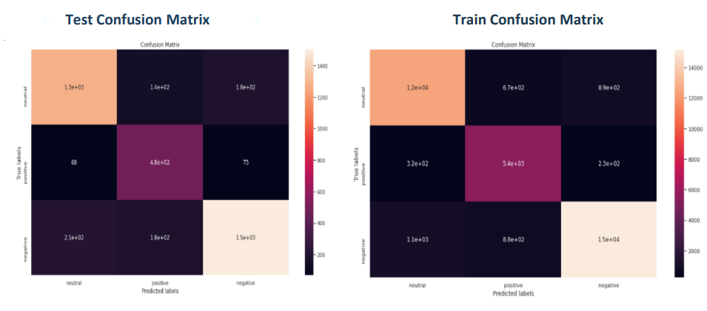
Confusion matrix for train and test data

Slide 25
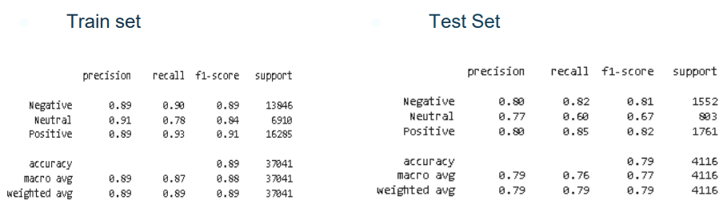
Classification report for train and test data

Slide 26
Conclusion
We are finally at the conclusion of our project!
Coming from the beginning we did EDA on the dataset and also cleaned the data according to our needs.After that we were able to draw relevant conclusions from the given data and then we trained our model on logistic regression.
For our model we were able to get the accuracy of 88% for the train set and accuracy of 80% for the test set using logistic regression.
Given the size of data and the amount of irrelevance in the data , the above score is good.

Slide 27
Thank You

